Slide 1

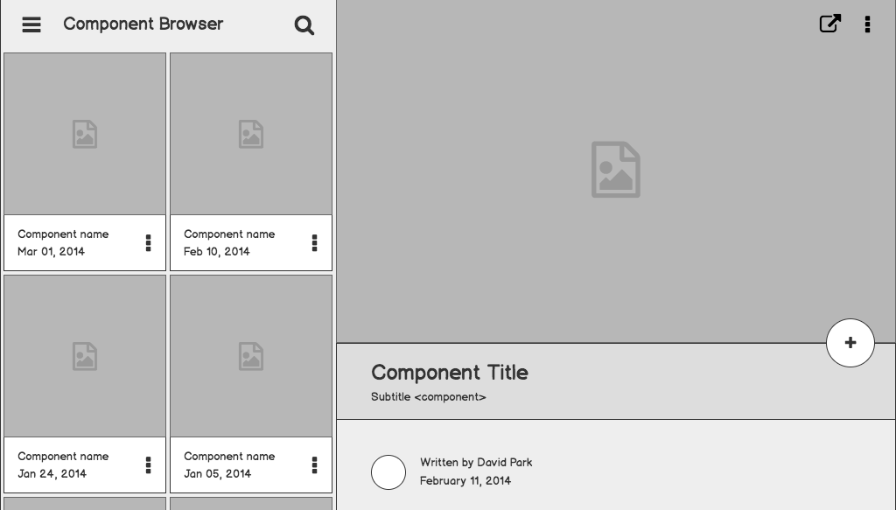

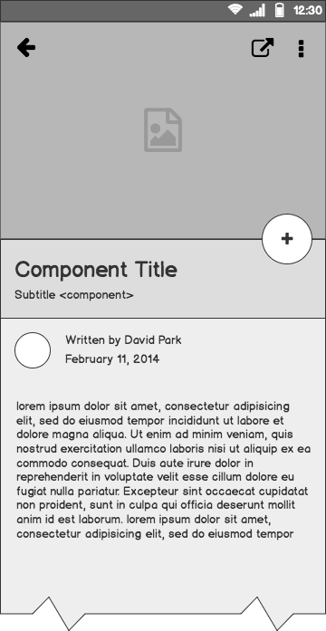
Exam Cell Automation
Simplifying the Examination Hall Allocation and Management
Submitted By :
Anju N | Nisary TS | Aashrith N

Slide 2
Contents
Existing System
Proposed System
Module Description
Tables
Structural Diagram

Slide 3
Outline
Exam Cell Automation System is developed for the college to simplify Examination Hall Allocation and Time Table Generation.
The purpose of developing this system is to computerize the traditional way of managing Exam Cell Activities.

Slide 4

Existing System :
The Problem

Slide 5
01
Time Consuming & Less Efficient
Existing system is very slow and inefficient.
More time and energy is wasted to allocate the halls for different exams. This may even lead the way to erroneous reports and may rise chances for anomalies and redundancy.

Slide 6
02
More Manual Work Required
& Less Accurate
Existing system still stuck into pen and paper.
Current Exam Cell Activities mostly include a lot of manual calculations and is mostly paper based. When the calculations are done manually, it may lead to more errors. There is lot of manual work involved in current system and mistake in one detail can lead to wrong generation of data.

Slide 7
03
Not at all User Friendly
Existing system forces user to do all the work.
All the maintenance and logical calculations are done manually by the user, which in turn leads to a burden of work. Also a small error in any detail between the manual task may rise to a large problem which becomes a heavy task as well.

Slide 8

Proposed System :
The Solution

Slide 9

01
User Friendly
1
The System is User Friendly for the retrieval and storing of data. And it is fast to store the data. It is maintained efficiently. The graphical user interface is implemented in this proposed system. It is more efficient than existing system.

Slide 10

02
Reports Are Generated Easily
Report like Hall Allocation can be easily generated in this proposed system. By this the user can generate the report as per the requirement and their wish for the duration of month or the day.

Slide 11

03
Very Less Paperwork
The proposed system requires very less paper work. All the data is entered into the computer and report can be generated by the help of computers, so that work become very easy because there is no need to keep data on more papers.

Slide 12

04
Computer Operator Control
Computer Operator Control is available so rate of errors will be less. Storing and retrieving of information is simple. So work can be done correct time and also good speed.

Slide 13
Modules

Slide 14
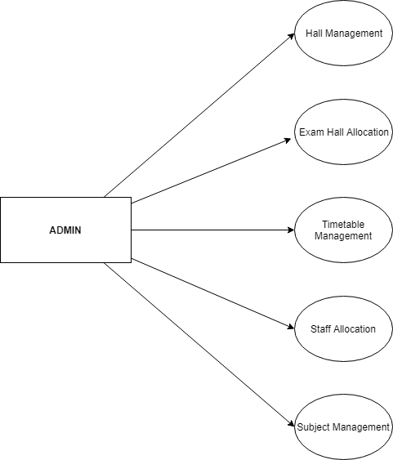
ADMIN MODULE
The different features for Admin are :
Hall Management
Exam Hall Allocation
Timetable Management
Staff Allocation
Subject Management

Slide 15
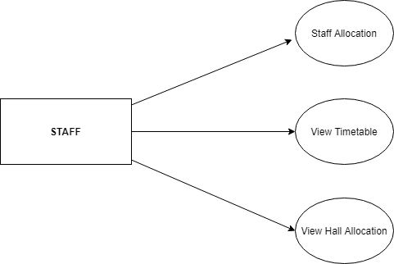
STAFF MODULE
The different features for Staffs are :
Staff Allocation
View Time Table
View Hall Allocation

Slide 16
Tables

Slide 17
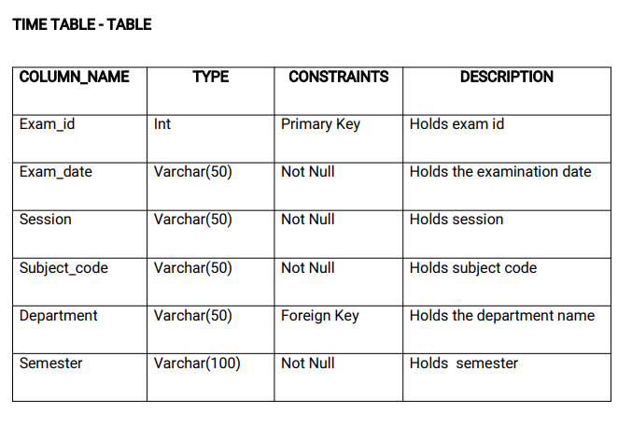

Slide 18
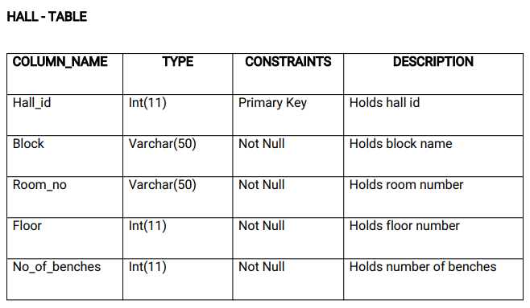

Slide 19
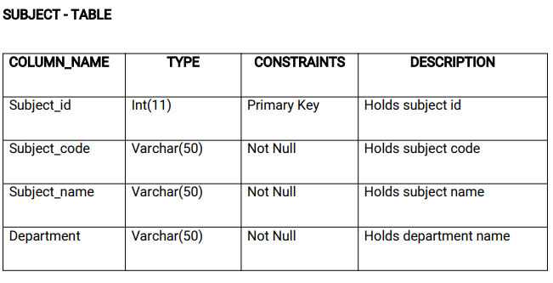

Slide 20
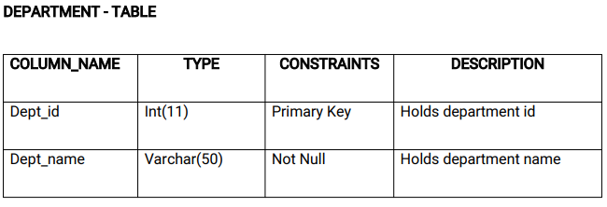

Slide 21
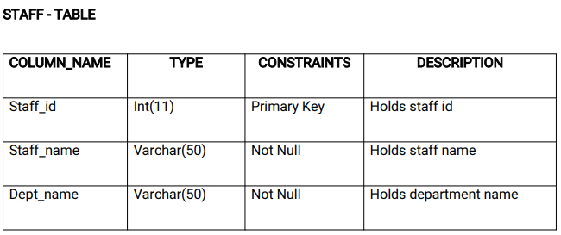

Slide 22
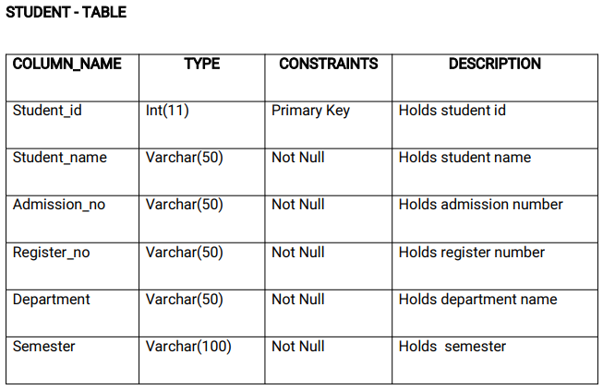

Slide 23
Structural Diagrams

Slide 24
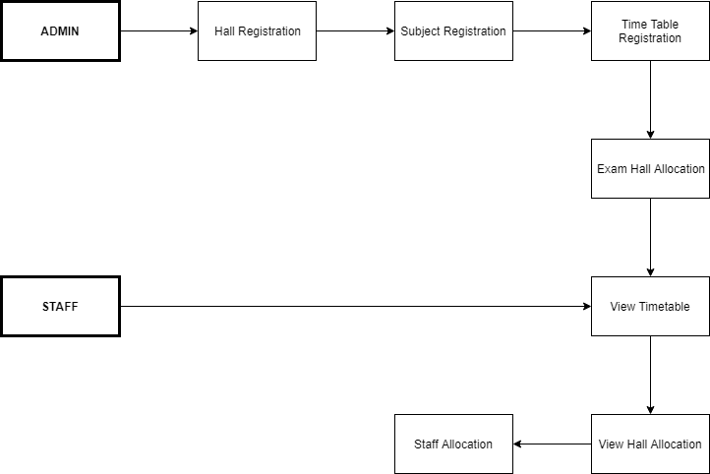
Data Flow
Diagram

Slide 25
Thank You

